Slide 1




NS2
Project Proposal
Md. Shahrukh Islam
Student ID: 1805098

Slide 2
The Paper:
The Peak-Hopper: A New End-to-End Retransmission Timer for Reliable Unicast Transport
Link: https://www.cs.helsinki.fi/u/gurtov/reiner/PeakHopper_draft0207.pdf

Slide 3
Overview
Modified mechanism for RTT calculation
TCP Retransmission Time Out (RTO) and Round-Trip Time (RTT)
Two RTO algorithm runs in parallel.
One is Short-Term History RTO.
Another one is Long-Term History RTO.

Slide 4
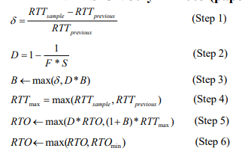
Calculating RTO [From the Paper]
Notes:
Delta = (RTT sample – RTT previous)/RTT previous
D= 1- (1/(F*S)) B = max(delta, D*B)
RTT_{max} =max(RTT sample , RTT previous)
RTO=max(D*RTO, (1+B)*RTTmax)
RTO=max(RTO, RTOmin)

Slide 5
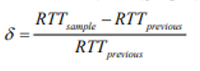
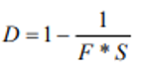
Explanation
Step 1 | Having collected a new RTT sample, RTT_{sample} (in the picture), we compare this value to the previous RTT sample collected, RTT_{previous} (in the picture), as shown in Step 1. We call the normalized change between these two samples δ. This is the measure of the short-term changes in RTT.
Step 2 | D is decay factor. D determines how rapidly the RTO is decayed. F is fade variable, which controls the speed of this decay (a high F gives a slow decay and a low F gives a high decay).

Slide 6
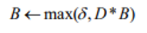
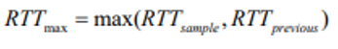
Explanation
Step 3 | We calculate a booster variable B. The booster variable determines how high the RTO should hop when a large RTT increase has been detected.
Step 4 | We set RTTmax to the maximum of the new RTT sample, RTTsample, and the previous RTT sample, RTTprevious. RTTmax is used to represent the short-term history of the RTT

Slide 7
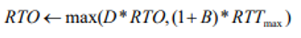
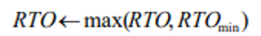
Explanation
Step 5 | We set RTO to the maximum of a long-term history (represented by the term D*RTO ) and the short-term history (represented by the term ((1+B)*RTTmax).
Step 6 | we ensure that the RTO does not fall below the minimum allowed RTO.

Slide 8
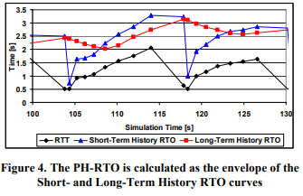
Expected Output

Slide 9
Thank you.

